Slide 1
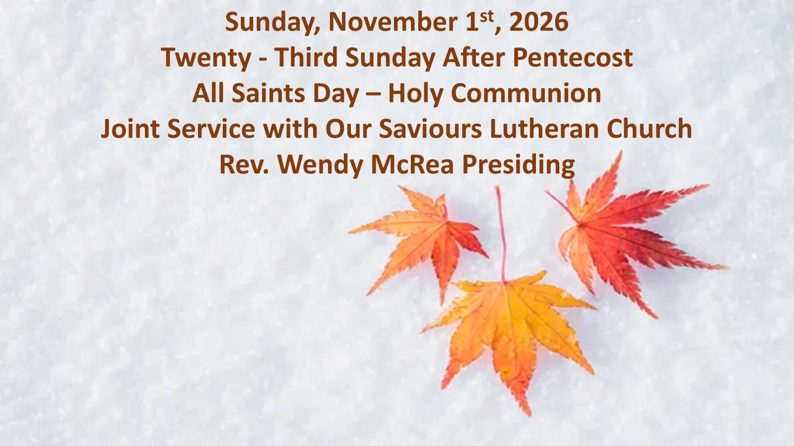

Slide 2
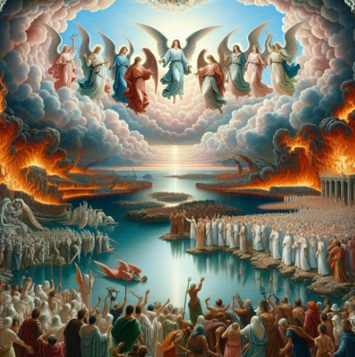
They are before the throne of God, and he who sits upon the throne will shelter them with his presence.
Revelation 7:15

Slide 3
Opening Hymn:
Common Praise #281
Who Are These Like Stars Appearing
Text: Theobald Heinrich Schenck (1656-1727)
tr, Frances Elizabeth Cox (1812-1897)

Slide 4
Who are these like stars appearing,
these before God’s throne who stand?
Each a golden crown is wearing;
who are all this glorious band?
“Al – le – lu - ia!” hark they sing,
praising loud their heavenly King.

Slide 5
Who are these in dazzling brightness,
clothed in God’s own righteousness?
These whose robes of purest whiteness
shall their lustre still possess,
still untouched by time’s rude hand-
whence come all this glorious band?

Slide 6
These are they who have contended
for their Saviour’s honour long,
wrestling on till life was ended,
following not the sinful throng;
these, who well the fight sustained,
triumph through the Lamb have gained.

Slide 7
These are they whose hearts were riven,
sore with woe and anguish tried,
who in prayer full oft have striven
with the God they glorified;
now their painful conflict o’er’
God has bid them weep no more.

Slide 8
These, the Almighty contemplating,
did as priests before him stand,
soul and body always waiting
day and night at his command:
now, in God’s most holy place,
blest they stand before his face.
Last Verse

Slide 9
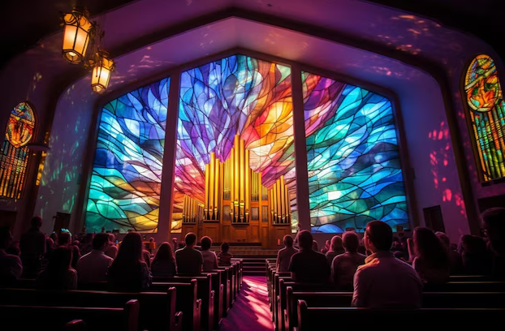
Gathering of the Community

Slide 10
The grace of our Lord Jesus Christ,
and the love of God,
and the fellowship of the Holy Spirit,
be with you all.
And also with you.

Slide 11
Almighty God, to you all hearts are open, all desires known, and from you no secrets are hidden.
Cleanse the thoughts of our hearts by the inspiration of your Holy Spirit, that we may perfectly love you, and worthily magnify your holy name; through
Christ our Lord. Amen.

Slide 12
Glory to God
Glory to God in the highest
and peace to his people on earth.
Lord God, heavenly king,
almighty God and Father,
we worship you, we give you thanks,
we praise you for your glory.

Slide 13
Lord Jesus Christ, only Son of the Father,
Lord God, Lamb of God, you take away the sin of the world: have mercy on us; you are seated at the right hand of the Father: receive out prayer.

Slide 14
For you alone are the Holy One, you alone are the Lord, you alone are the Most High,
Jesus Christ, with the Holy Spirit, in the glory of God the Father. Amen.

Slide 15
The Collect of the Day
Almighty God, whose people are knit together in one holy Church, the mystical Body of your Son, grant us grace to follow your blessed saints in lives of faith and commitment, and to know the inexpressible joys you have prepared for those who love you; through Jesus Christ our Lord, who lives and reigns with you and the Holy Spirit, one God, now and for ever.
Amen.

Slide 16
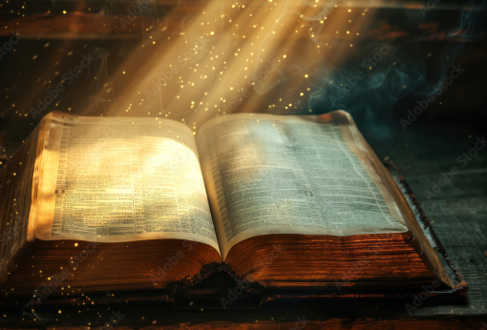
THE PROCLAMATION OF GOD’S WORD

Slide 17
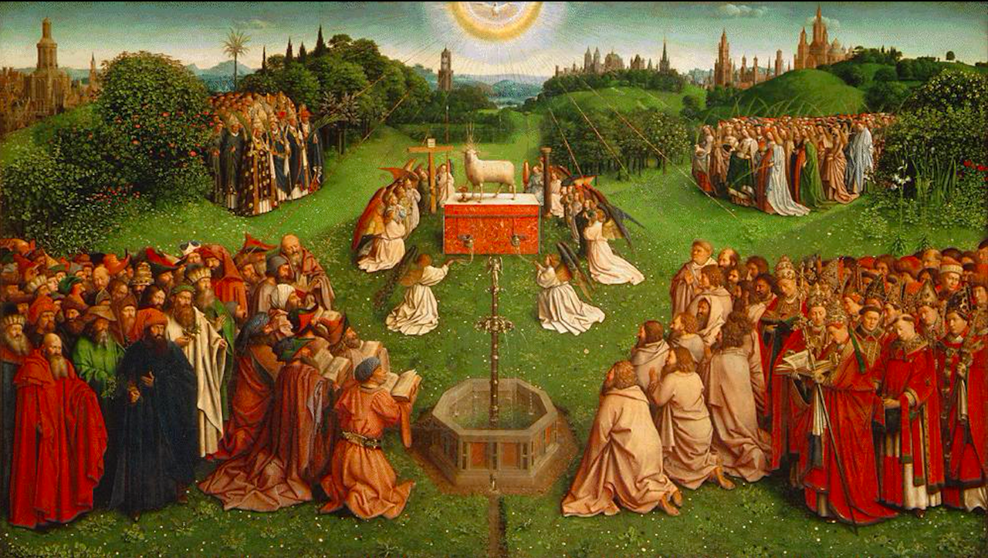
Revelation 7:9-17

Slide 18
A multitude sings before the Lamb
After this I looked, and there was a great multitude that no one could count, from every nation, from all tribes and peoples and languages, standing before the throne and before the Lamb, robed in white, with palm branches in their hands. They cried out in a loud voice, saying, "Salvation belongs to our God who is seated on the throne and to the Lamb!" And all the angels stood around the throne and around the elders and the four living creatures, and they fell on their faces before the throne and worshiped God, singing,

Slide 19
"Amen! Blessing and glory and wisdom and thanksgiving and honor and power and might be to our God forever and ever! Amen." Then one of the elders addressed me, saying, "Who are these, robed in white, and where have they come from?" I said to him, "Sir, you are the one who knows." Then he said to me, "These are they who have come out of the great ordeal; they have washed their robes and made them white in the blood of the Lamb. For this reason they are before the throne of God and worship him day and night within his temple, and the one who is seated on the throne will shelter them.

Slide 20
They will hunger no more and thirst no more; the sun will not strike them, nor any scorching heat, for the Lamb at the center of the throne will be their shepherd, and he will guide them to springs of the water of life, and God will wipe away every tear from their eyes."
Hear what the Spirit is saying
Thanks to be God

Slide 21
Psalm 34:1-10, 22
I will bless the Lord at all times;*
He praise shall ever be in my mouth.
I will glory in the Lord;*
Let the humble hear and rejoice.
Proclaim with me the greatness of the Lord;*
Let us exalt his name together.
I sought the Lord, and he answered me*
And delivered me out of all my terror.

Slide 22
Look upon him and be radiant,*
And let not your faces be ashamed.
I called in my affliction and the Lord heard me*
And saved me from all my troubles.
The angel of the Lord encompasses those who fear him,*
And he will deliver them.
Taste and see that the Lord is good;*
Happy are they who trust in him!

Slide 23
Fear the Lord, you that are his saints,*
For those who fear him lack nothing.
The young lions lack and suffer hunger,*
But those who seek the Lord lack nothing that is good.
The Lord ransoms the life of his servants,*
And none will be punished who trust in him.

Slide 24
Hear us, Lord, when we cry to you. Calm our bodies and minds with the peace which passes understanding, and make us radiant, with the knowledge of your goodness; through Jesus Christ our Saviour.

Slide 25
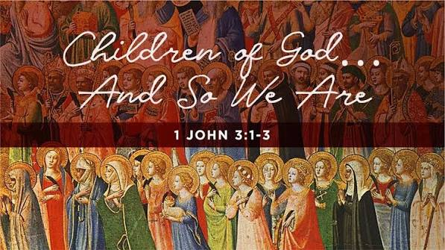

Slide 26
See what love the Father has given us, that we should be called children of God, and that is what we are. The reason the world does not know us is that it did not know him. Beloved, we are God's children now; what we will be has not yet been revealed. What we do know is this: when he is revealed, we will be like him, for we will see him as he is. And all who have this hope in him purify themselves, just as he is pure.
Hear what the Spirit is saying
Thanks to be God

Slide 27
Gradual Hymn
Songs for Gospel People
#94 – Ye Servants of God
Words: Charles Wesley (1744)
Music: William Gardiner (1815)

Slide 28
Ye servants of God, your Saviour proclaim,
and publish abroad that wonderful name;
The name all victorious of Jesus extol, whose kingdom is glorious and rules over all.

Slide 29
God ruleth on high almighty to save,
whose Word still is nigh, a presence we have.
The great congregation God’s triumph shall sing, ascribing salvation to Jesus our King.

Slide 30
Salvation to God, who sits on the throne!
Let all cry aloud, and honour the One.
The praises of Jesus the angles proclaim,
bow down in deep rev’rence and worship the Lamb.

Slide 31
Then let us adore and give as is right,
all glory and power, all wisdom and might,
all honour and bIessing with angels above,
and thanks never ceasing and infinite love.
Last verse

Slide 32
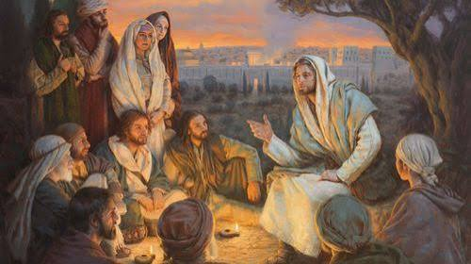
Matthew 5:1-12
The Lord be with you.
And also with you.
The Holy Gospel of our Lord Jesus Christ.
according to Matthew.
Glory to you,
Lord Jesus Christ

Slide 33
When Jesus saw the crowds, he went up the mountain, and after he sat down, his disciples came to him. And he began to speak and taught them, saying: Blessed are the poor in spirit, for theirs is the kingdom of heaven. Blessed are those who mourn, for they will be comforted. Blessed are the meek, for they will inherit the earth. Blessed are those who hunger and thirst for righteousness, for they will be filled. Blessed are the merciful, for they will receive mercy.

Slide 34
Blessed are the pure in heart, for they will see God. Blessed are the peacemakers, for they will be called children of God. Blessed are those who are persecuted for the sake of righteousness, for theirs is the kingdom of heaven. Blessed are you when people revile you and persecute you and utter all kinds of evil against you falsely on my account. Rejoice and be glad, for your reward is great in heaven, for in the same way they persecuted the prophets who were before you.
The Gospel of Christ.
Praise to you, Lord Jesus Christ.

Slide 35
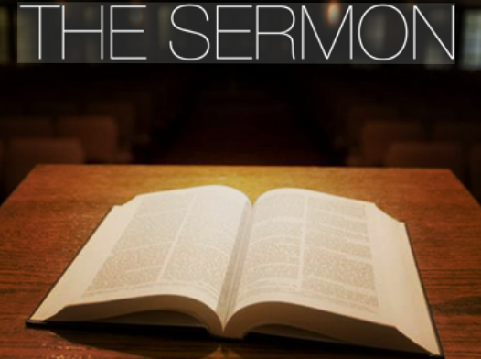

Slide 36
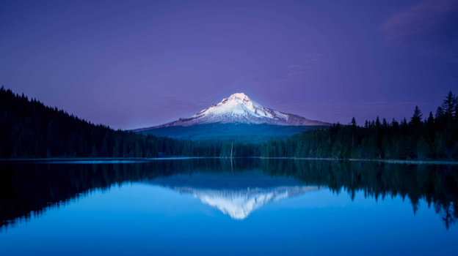
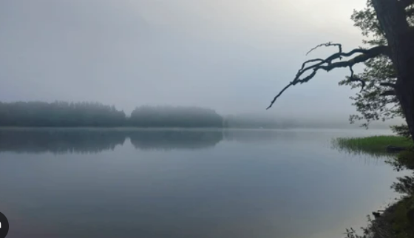
SILENT REFLECTION

Slide 37
The Apostles’ Creed
Let us confess the faith of our baptism, as we say, I believe in God, the Father almighty, creator of heaven and earth. I believe in Jesus Christ, his only Son, our Lord. He was conceived by the power of the Holy Spirit and born of the Virgin Mary. He suffered under Pontius Pilate, was crucified, died, and was buried.
He descended to the dead. On the third day he rose

Slide 38
again. He ascended into heaven, and is seated at the right hand of the Father. He will come again to judge the living and the dead. I believe in the Holy Spirit, the holy catholic Church, the communion of saints, the forgiveness of sins, the resurrection of the body, and the life everlasting.
Amen

Slide 39
All Saints celebrates the baptized people of God, living and dead, who are the body of Christ. As November heralds the dying of the landscape in many northern regions, the readings and liturgy call us to remember all who have died in Christ and whose baptism is complete. At the Lord’s table we gather with the faithful of ever time and place, trusting that the promises of God will be fulfilled and that all tears will be wiped awy in the new Jerusalem.

Slide 40

Today we light candles and with grateful hearts we remember all who have died
and now rest from their labours.
Reading of the Names

Slide 41
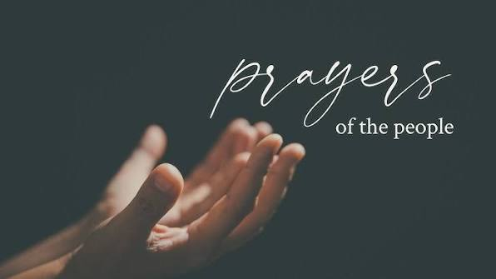

Slide 42
Confession and Absolution
Dear friends in Christ,
God is steadfast in love and infinite in mercy; he welcomes sinners and invites them to his table. Let us confess our sins, confident in God’s forgiveness.

Slide 43
Most merciful God,
we confess that we have sinned against you
in thought, word, and deed, by what we have
done, and by what we have left undone. We
have not loved you with our whole heart;
we have not loved our neighbours as
ourselves.

Slide 44
We are truly sorry and we humbly
repent. For the sake of your Son Jesus Christ,
have mercy on us and forgive us, that we may
delight in your will, and walk in your ways,
to the glory of your name.
Amen.

Slide 45
Almighty God have mercy upon you,
pardon and deliver you from all your sins,
confirm and strengthen you in all goodness,
and keep you in eternal life; through Jesus
Christ our Lord.
Amen.

Slide 46
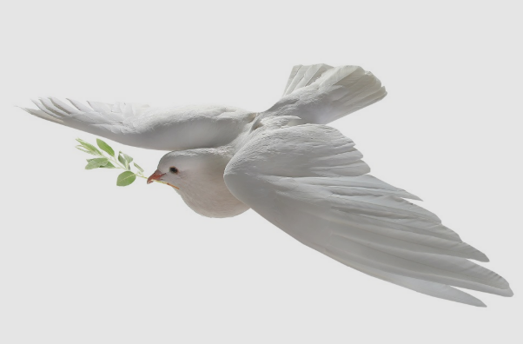
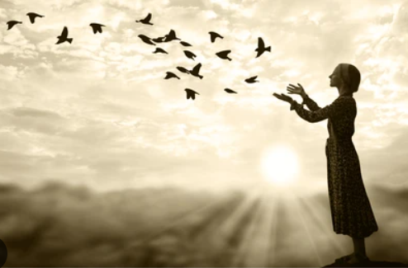
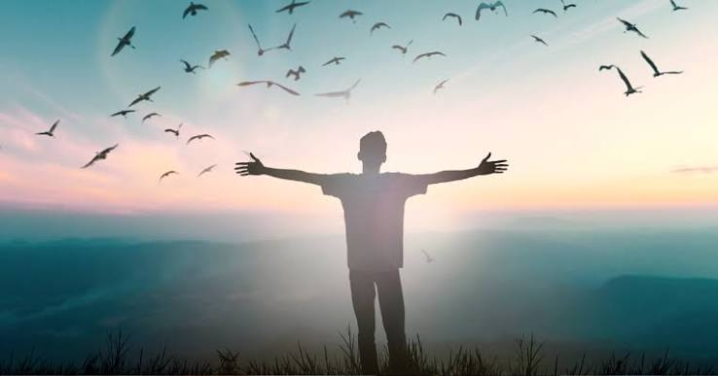
The peace of the Lord
be always with you.
And also with you.

Slide 47
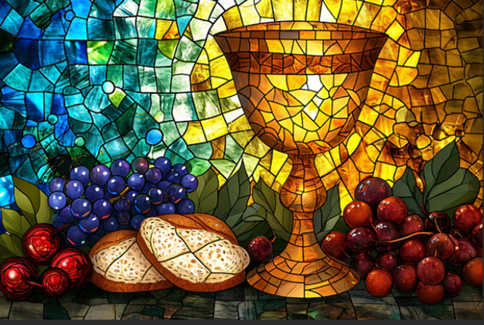
The Celebration of the Holy Eucharist

Slide 48
Offertory Hymn
Common Praise #378
Crown Him With Many Crowns
Text: Matthew Bridges (1800-1894)
Godfrey Thring (1823-1903)
Music: George Jobh Elvey (1816-1893)

Slide 49
Crown him with many crowns, the Lamb upon his throne;
hark, how the heavenly anthem drowns all music but its own!

Slide 50
Awake, my soul, and sing of him who died for thee,
and hail him as thy matchless King through all eternity.

Slide 51
Crown him the Lord of life, who triumphed o'er the grave,
and rose victorious in the strife for those he came to save.

Slide 52
His glories now we sing who died and rose on high,
who died eternal life to bring, and lives that death may die.

Slide 53
Crown him the Lord of peace, whose power a sceptre sways from pole to pole,
that wars may cease, absorbed in prayer and praise.

Slide 54
His reign shall know no end, and round his pierced feet
fair flowers of paradise extend their fragrance ever sweet.

Slide 55
Crown him the Lord of love; behold his hands and side,
rich wounds yet visible above, in beauty glorified.

Slide 56
All hail, Redeemer, hail! for thou hast died for me;
thy praise shall never, never fail throughout eternity.
Last Verse

Slide 57
PRAYER OVER THE GIFTS
Holy and mighty God, we give you thanks for the triumph of Christ in the lives of all his saints. Receive all we offer you this day, and help us, like them, to run our course with faith, that we may come to your eternal kingdom. We ask this in the name of Jesus Christ the Lord.
Amen.

Slide 58
Eucharistic Prayer #4
The Lord be with you.
And also with you.
Lift up your hearts.
We lift them to the Lord.
Let us give thanks to the Lord our God.
It is right to give our thanks and praise.

Slide 59
It is right to give you thanks and praise,
O Lord, our God, sustainer of the universe, you are worthy of glory and praise.
Glory to you for ever and ever.

Slide 60
At your command all things came to be: the vast expanse of interstellar space, galaxies, suns, the planets in their courses, and this fragile earth, our island home; by your will they were created and have their being.
Glory to you for ever and ever.

Slide 61
From the primal elements you brought forth the human race, and blessed us with memory, reason, and skill;
you made us the stewards of creation.
Glory to you for ever and ever.

Slide 62
But we turn against you, and betray your trust; and we turn against one another.
Again and again you call us to return.
Through the prophets and sages you reveal your righteous law.

Slide 63
In the fullness of time you sent your Son, born of a woman, to be our Saviour. He was wounded for our transgressions, and bruised for our iniquities. By his death he opened to us
the way of freedom and peace.
Glory to you for ever and ever.

Slide 64
Therefore we praise you,
joining with the heavenly chorus,
with prophets, apostles, and martyrs,
and with those in every generation
who have looked to you in hope,
to proclaim with them your glory,
in their unending hymn:

Slide 65
Holy, holy, holy Lord,
God of power and might,
heaven and earth are full of your glory.
Hosanna in the highest.
Blessed is he who comes in the name of the Lord.
Hosanna in the highest.

Slide 66
Blessed are you, Lord our God,
for sending us Jesus, the Christ,
who on the night he was handed over to suffering and death,
took bread, said the blessing, broke the bread, gave it to his friends,

Slide 67
and said, “Take this, and eat it: this is my body which is given for you.
Do this for the remembrance of me.”
In the same way, after supper,
he took the cup of wine;
he gave you thanks,

Slide 68
and said, “Drink this, all of you:
this is my blood of the new covenant, which is shed for you and for many for the forgiveness of sins.
Whenever you drink it, do this for the remembrance of me.”
Glory to you for ever and ever.

Slide 69
Gracious God,
we recall the death of your Son Jesus Christ, we proclaim his resurrection and ascension, and we look with expectation for his coming
as Lord of all the nations.

Slide 70
We who have been redeemed by him,
and made a new people by water and the Spirit,
now bring you these gifts.
Send your Holy Spirit upon us

Slide 71
and upon this offering of your Church,
that we who eat and drink at this holy table
may share the divine life of Christ our Lord.
Glory to you for ever and ever.

Slide 72
Pour out your Spirit upon the whole earth
and make it your new creation.
Gather your Church together
from the ends of the earth into your kingdom,
where peace and justice are revealed,

Slide 73
that we, with all your people,
of every language, race, and nation,
may share the banquet you have promised;
through Christ, with Christ, and in Christ,

Slide 74
all honour and glory are yours,
creator of all.
Glory to you for ever and ever.
Amen.

Slide 75


Slide 76
BAS Page 211
As our Saviour taught us, let us pray,
Our Father in heaven,
hallowed be your name,
your kingdom come,
your will be done,
on earth as in heaven.
Give us today our daily bread.

Slide 77
Forgive us our sins as we forgive those who sin against us.
Save us from the time of trial,
and deliver us from evil.
For the kingdom, and the power, and the glory are yours,
now and for ever. Amen.

Slide 78
The Breaking of the Bread
We break this bread to share in the body of Christ.
We, being many, are one body, for we all share in the one bread.
These are the gifts of God for you the People of God.
Thanks be to God.

Slide 79
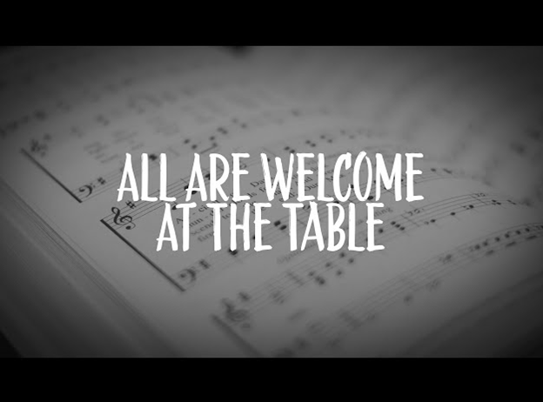
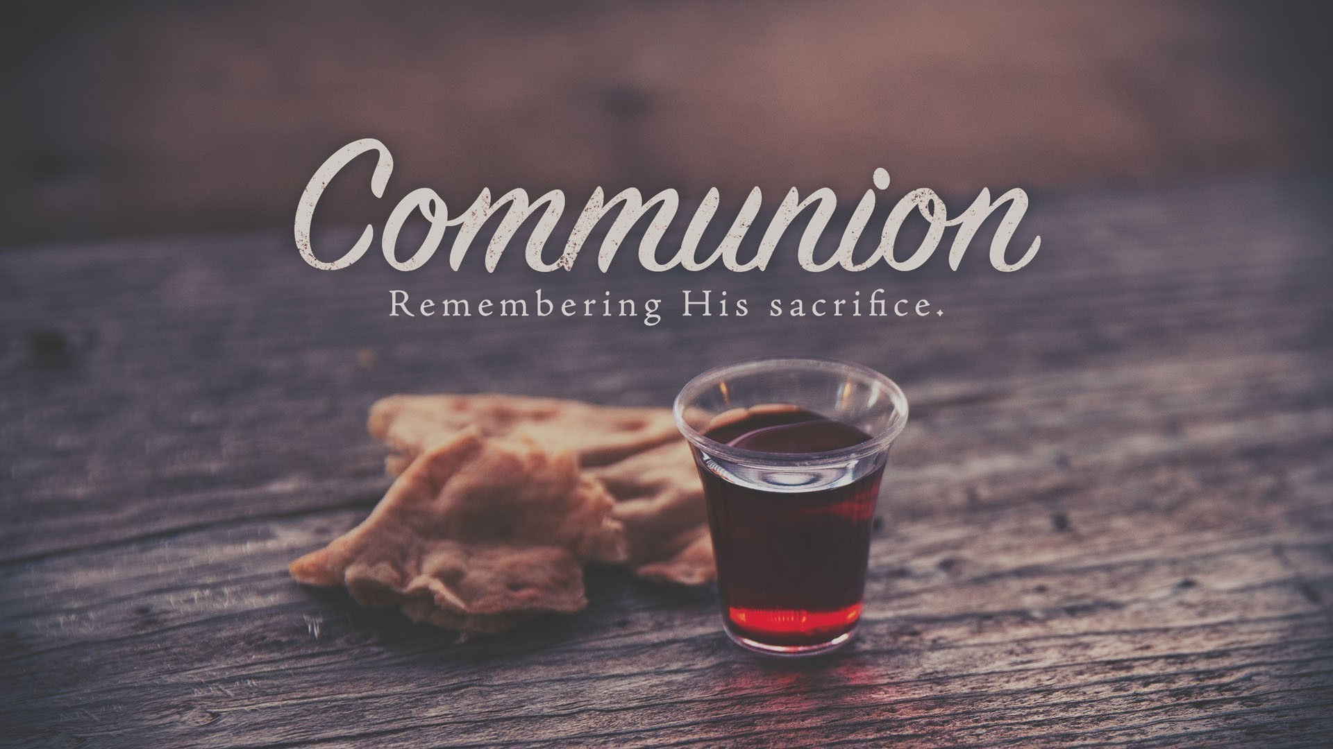

Slide 80
Communion Hymn:
Songs for Gospel People # 69
Jesu, Jesu, Fill Us With Your Love
Words: Tom Colvin, 1969
Music: Ghanaian fold song; adapt. Tom Colvin: arr. Jane Marshall

Slide 81
Jesu, Jesu, fill us with your love, show us how to serve the neighbours we have from you.
Kneels at the feet of his friends,
Silently washes their feet,
Master who acts as a slave to them.

Slide 82
Jesu, Jesu, fill us with your love, show us how to serve the neighbours we have from you.
Neighbours are rich men and poor,
neighbours are black men and white,
neighbours are nearby and far away.

Slide 83
Jesu, Jesu, fill us with your love, show us how to serve the neighbours we have from you.
These are the ones we should serve,
these are the ones we should love.
All are neighbours to us and you.

Slide 84
Jesu, Jesu, fill us with your love, show us how to serve the neighbours we have from you.
Loving puts us on our knees, serving as tho’ we are slaves, this is the way we should live with you.

Slide 85
Jesu, Jesu, fill us with your love, show us how to serve the neighbours we have from you.
Kneel at the feet of our friends,
silently washing their feet,
This is the way we should live with you.

Slide 86
Jesu, Jesu, fill us with your love, show us how to serve the neighbours we have from you.
Last Verse

Slide 87
Prayer After Communion
Lord of hosts, we praise your glory reflected in your saints. May we who share at this table be filled with the joy of your eternal kingdom, where Jesus is Lord, now and for ever.
Amen.

Slide 88
Doxology
Glory to God,
whose power, working in us, can do infinitely
more than we can ask or imagine. Glory to
God from generation to generation, in the
Church and in Christ Jesus, for ever and ever.
Amen.

Slide 89
The Blessing
The peace of God, which passes all understanding, keep your hearts and minds filled with the knowledge and love of God, and of his Son Jesus Christ our Lord: And the blessing of God almighty, the Father, the Son, and the Holy Spirit be amongst you and remain with you and those you love this day and forever. Amen

Slide 90
Closing Hymn
Common Praise #438
O Jesus, I Have Promised
John Ernest Bode (1869)

Slide 91
O Jesus, I have promised
to serve Thee to the end;
be Thou forever near me,
my Master and my Friend;

Slide 92
I shall not fear the battle
if Thou art by my side,
nor wander from the pathway
if Thou wilt be my Guide.

Slide 93
O let me feel Thee near me,
the world is ever near;
I see the sights that dazzle,
the tempting sounds I hear;

Slide 94
my foes are ever near me,
around me and within;
but, Jesus, draw Thou nearer,
and shield my soul from sin.

Slide 95
O Jesus, thou hast promised
to all who follow Thee,
that where Thou art in glory
there shall Thy servant be; and,

Slide 96
Jesus, I have promised to serve
thee to the end!
O give me the grace to follow,
my Master and my Friend.

Slide 97
O let me see thy footmarks
and in them plant my own:
my hope to follow duly
is in they strength alone.

Slide 98
O guide me, call me, draw me,
uphold me to the end;
and then in heaven receive me,
my Saviour and my Friend
Last verse

Slide 99

Let us go forth in peace to love and serve the Lord.
Thanks be to God

Slide 100
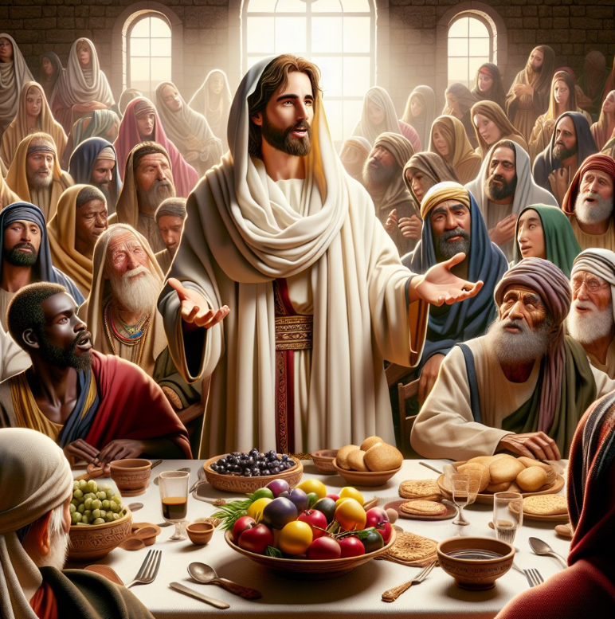
FOLLOWING THE SERVICE
PLEASE JOIN US FOR
HIDDEN HOST
AT THE PRINCE GEORGE GOLF AND CURLING CLUB

